Slide 1
Uses of Blockchain
Functional Programming
Data Analysis on Blockchain technology & Bitcoin.
Notes:
To change the image on this slide, select the picture and delete it. Then click the Pictures icon in the placeholder to insert your own image.

Slide 2
What is Data Analysis?
Data analysis is a process of inspecting, filtering, transforming, and modeling data with the goal of discovering useful information, informing conclusions, and supporting decision-making.
Data Analysis contributes to more scientific decision-making and more efficient business operation in the modern business world.

Slide 3
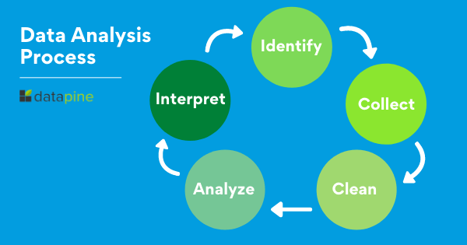
Process in Data Analysis

Slide 4

Tools for Data Analysis
Fortunately, various tools are readily available to speed up the procedure. Open-source tools, like Open Refine, are great for both high-level inquiry and fundamental data clean up.
Python libraries (like Pandas) and some R tools work well for intensive
data cleaning.
Why Excel?
Analyze Data in Excel empowers you to understand your data through natural language queries that allow you to ask questions about your data without having to write complicated formulas.

Slide 5
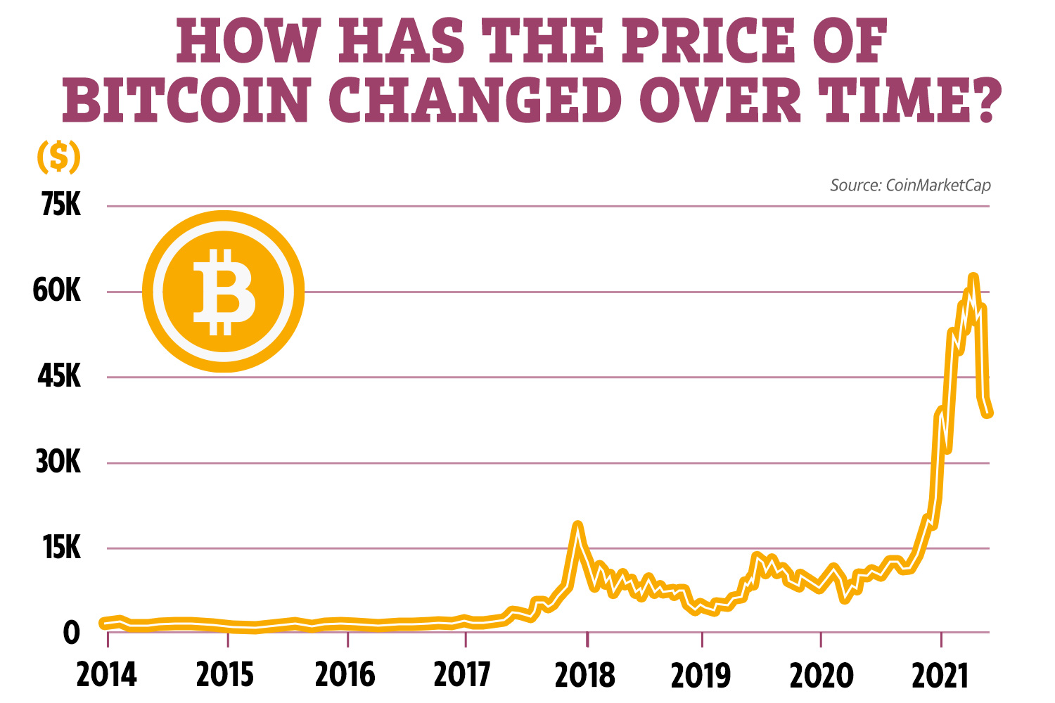
About the Dataset
The Data set is collected from Kaggle.com
The reference graphs are collected from Statista.com

Slide 6
Topics to be covered for Analysis
Bitcoin Historical Price
Blockchain Technology use Cases
Top countries with most Crypto Owners

Slide 7

What is blockchain technology?
Blockchain is a system of recording information in a way that makes it difficult or impossible to change, hack, or cheat the system.
A blockchain is essentially a digital ledger of transactions that is duplicated and distributed across the entire network of computer systems on the blockchain

Slide 8
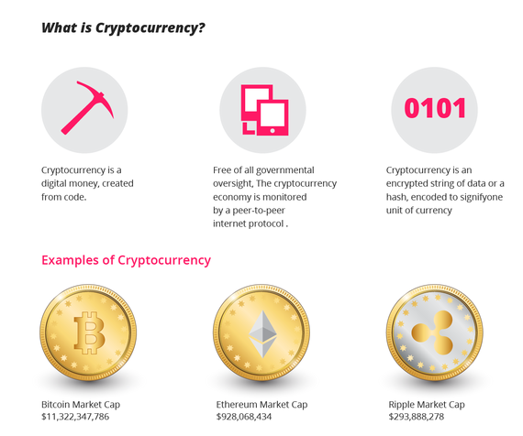
What is Crypto Currency?

Slide 9

Data Before Cleaning

Slide 10

Data After Cleaning

Slide 11
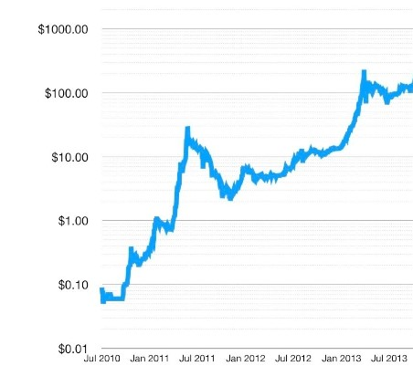
Bitcoin Historical Price
The price of a Bitcoin was nearly at $0.09 in 2009.
Real adoption of Bitcoin began to take place about four years later, and a major Bitcoin price surge happened for the first time.
Bitcoin Attracts Investors in 2013
Bitcoin’s price trajectory began to change in 2013.
Starting at $13 in the beginning of 2013, the price of Bitcoin rose to almost $250 in April when the Electronic Frontier Foundation (EFF) began accepting Bitcoin.
.

Slide 12
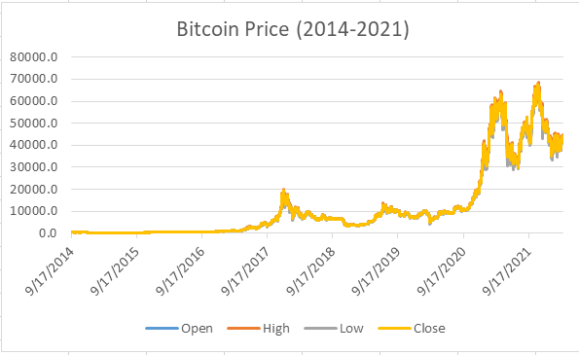
Bitcoin Historical Price
The Bitcoin price in 2017 breached the $1,100 mark in January, a new record high at the time. By December, the price had soared to nearly $20,000. That’s a 20x rise in less than 12 months.
Bitcoin has shown a massive price growth, reached an all-time high in 2021, as values exceeded over 65,000 USD in November 2021 when the CEO of Tesla, Elon Musk has announced that he has bought $1.5 billion worth of Bitcoin and also said it will start accepting payments in Bitcoin in exchange for its products.

Slide 13
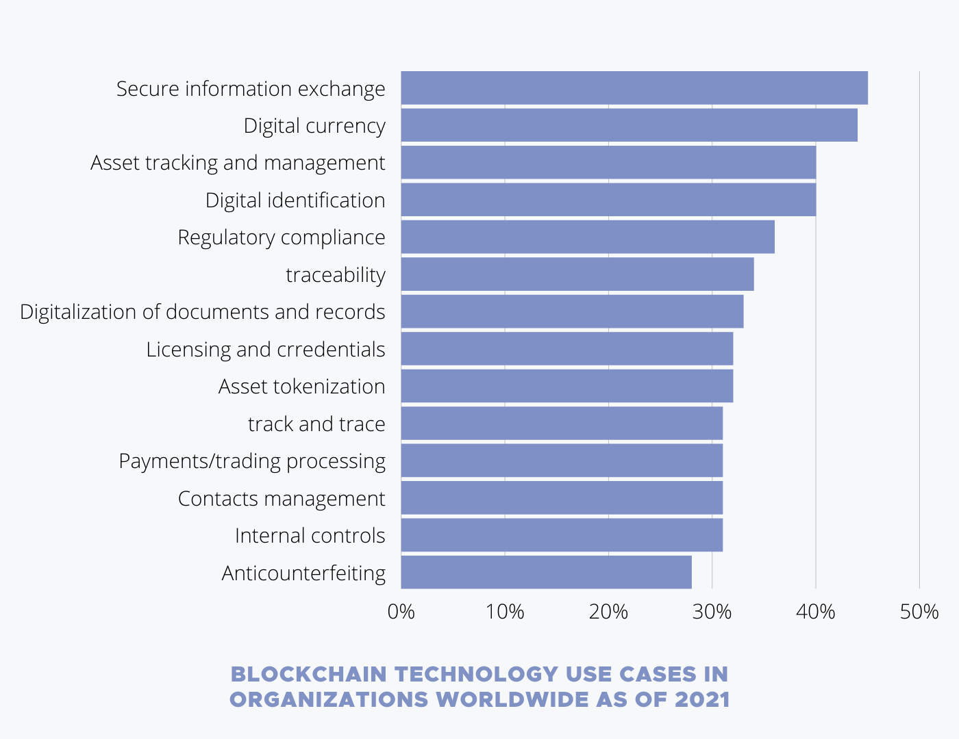
Blockchain Technology Use Cases
Blockchain has so many applications in every sector, such as healthcare, finance, government, identity, etc.
According to the research, in 2021, the top three Blockchain use cases are the following:
45% of companies use Blockchain to secure internal or external information exchange;
44% of companies use Blockchain for operations related to digital currencies;
40% of use cases are based on asset tracking and management.

Slide 14
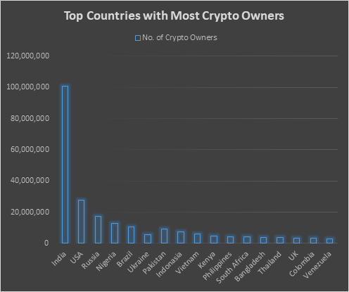
Top Countries with Most Crypto Owners
Bitcoin and cryptocurrency adoption has grown over 800% in the past year
Top 5 countries with most cryptocurrency holders are the following,
India 100 million
USA 27 million
Russia 17 million
Nigeria 13 million
Brazil 10 million
India has more cryptocurrency holders than any other country, i.e., more than 100 million people owns cryptocurrency.

Slide 15
Pros & Cons of Cryptocurrency
Pros
Lower transaction cost
Faster processing of transaction
Secure and Private
Worldwide Acceptance/Cost Reduction
Decentralization/Increase transparency
Cons
It has no physical form or intrinsic value
High volatility ,High risk ,Large potential losses and not all Cryptocurrency are the same

Slide 16
Conclusion
Cryptocurrencies and Blockchains are very new technologies:
Like all new technologies they are uncertain and has a high risk.
Cryptocurrency landscape is still evolving, over the next few years we are more likely to see more global standards being adopted to this technology.
In order for Cryptocurrency to succeed more people need to understand what it is.
Note: This is not a financial advice, it is only for learning purpose.

Slide 17
THANK YOU

